Slide 1


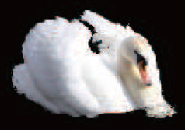

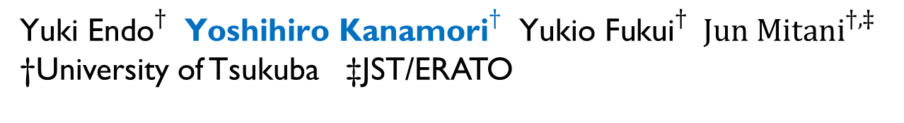
Matting and Compositing for Fresnel Reflection on Wavy Surfaces
$\text{Yu}{\text{ki} \text{Endo}}^{†} { \text{Yoshihiro} \text{Kanamori}}^{†} { \text{Yukio} \text{Fukui}}^{†} {Jun Mitani}^{†, ‡}$ †University of Tsukuba ‡JST/ERATO

Slide 2





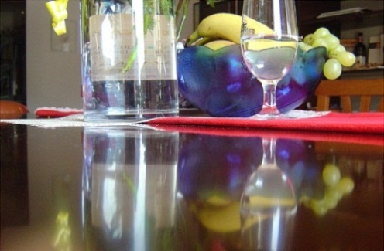
Background
Reflected scenes are popular photographic subjects
Reflection on water surfaces
… and glossy tabletops
Notes:
Scenes reﬂected on surfaces are popular photographic subjects, as are seen by a quick image search on the Internet.
Here I show you some examples. We can see reflection at not only water surfaces but also glossy tabletops.

Slide 3
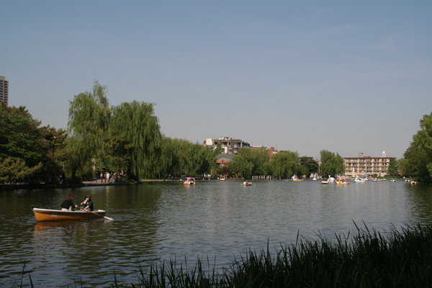
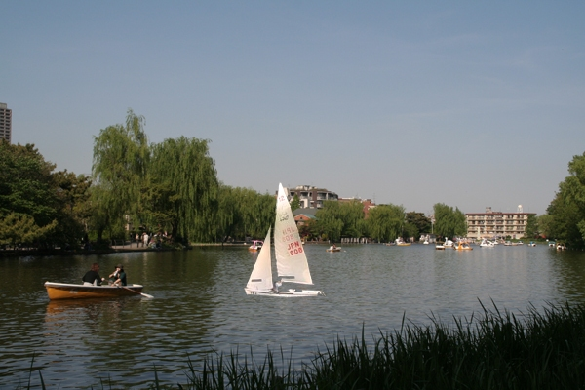
Background
Reflected scenes are popular photographic subjects
Color should be different
?
Shape should be warped
Notes:
Image editing to composite such reflection is quite interesting, but it’s not easy especially in case of reflection on wavy surfaces.
On a wavy surface like this, the reflection image should be warped, but editing such effects is difficult using conventional software.

Slide 4
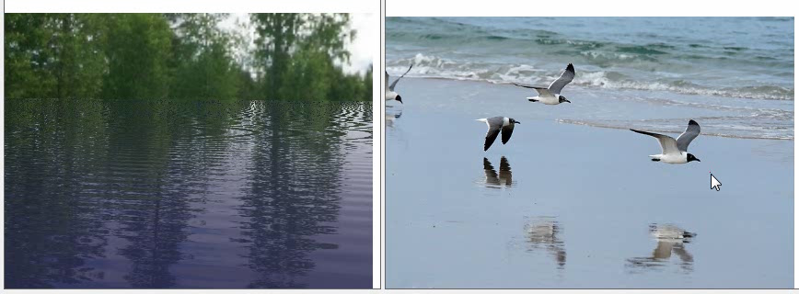
Our Goal
Composition with plausible reflection on wavy surfaces
We extract an α matte from a single image
First method for matting of complicated reflection
Notes:
We thus propose a technique to reproduce such reflection when compositing an image. The bottom movie demonstrates our method.
A user can composite plausible reflection image of the new object in real time.
To handle this, we propose a matting method to deal with reflection in the input image.

Slide 5



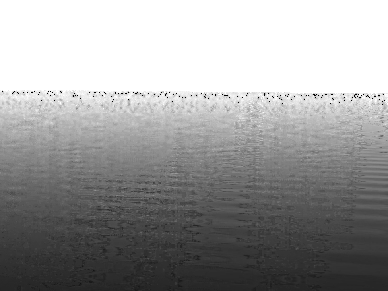
Reflection Matting
Given input image, we decompose it into 3 components
Input image
Reflection component
Transmission component (assumed as uniform)
α matte
Notes:
In general, matting means to decompose a single image into multiple images and an alpha matte.
The alpha matte contains the ratios for blending the decomposed images.
In our work, we decompose the reflection region in the input image into, a reflection component, transmission component and alpha matte.
In the next slides, I explain the related work on matting.

Slide 6
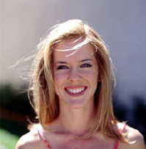
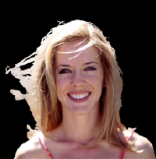


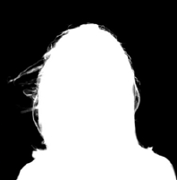
Related Work
Natural image mattings in survey [Wang and Cohen 2008]
extract foreground objects and an α matte from a single image
not applicable to reflection images
Input image & Trimap
Foreground objects & α matte
Composite result
Notes:
Typically, matting targets extraction of a foreground object and the corresponding alpha matte.
To compute the alpha matte, a user often provides a trimap, which consists of three kinds of regions.
That is, definitely-foreground, definitely-background and unknown regions.
Unfortunately, a trimap is not available in our case because there are no definitely-foreground or definitely-background regions in a reflection image.
So, we cannot use conventional matting methods to our problem directly.
前景物体のマッティングは、髪の毛など、背景に透過している前景物体を綺麗に切り出し、合成する手法です。
この手法は前景領域, 背景領域, 未確定領域からなるトライマップを用いて、
入力画像中に存在する前景と背景の情報を利用してαマットを計算しています。
本研究の映り込みのマッティングでは、前景物体のマッティングよりも画像中に使える情報が少なく、そもそもの前提条件が異なるため、
前景物体のマッティング手法をそのまま映り込みのマッティングに利用することはできません。

Slide 7
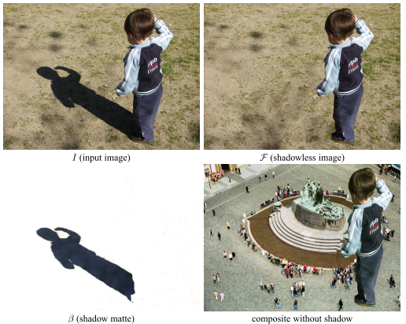
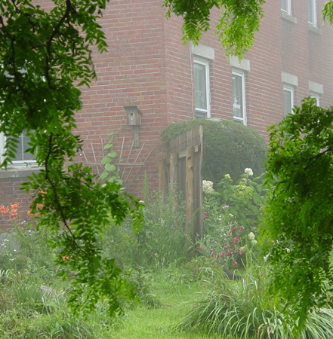
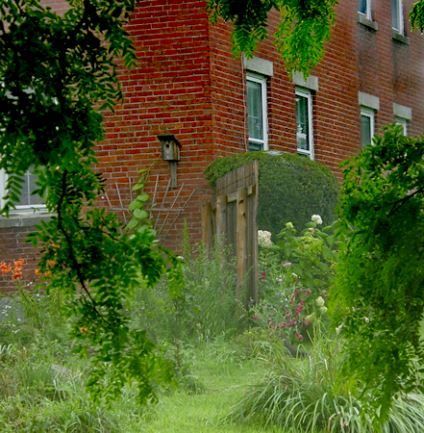
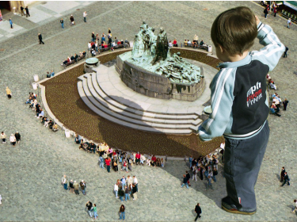
Related Work
Single-image matting methods for optical phenomena
Shadow [Wu et al. 2007]
Haze [Fattal 2008, He et al. 2009]
Natural shadow matting [Wu et al. 2007]
Single Image Dehazing [Fattal 2008]
Notes:
Recently, matting methods for optical phenomena have been proposed for handling shadows, haze and so on.
Here I explain the refraction matting technique, as the most related one to our method.
Please look at the input image on the left. You can see a transparent dolphin made of glass.
This method decomposes the dolphin image into hightlight, transmitted color and a warping function
in order to synthesize it later onto a new background, as shown right.
Unlike our method, this method assumes that highlight is white, which is not true in the reflection images.
In addition, this method requires many user interactions to specify warping.

Slide 8
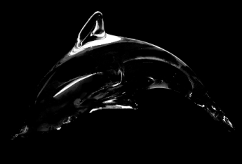

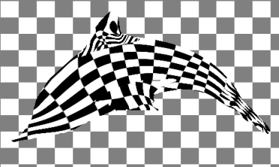
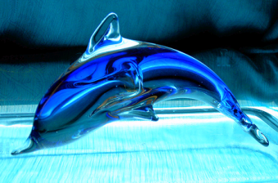
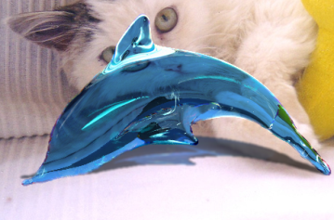

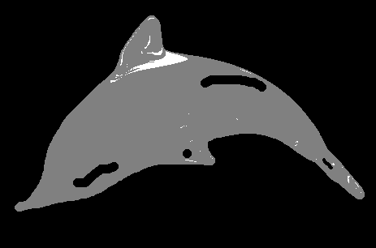
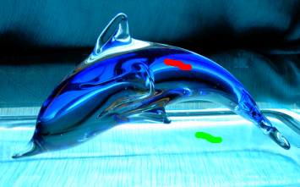
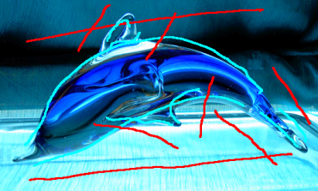
Related Work
Refraction matting for a glass [Yeung et al. 2011]
The reflection component is limited to white highlights
Manual specification of small-scale warping caused by a reflection surface is impractical
Matting results
Input image
Composite result
User markups
Notes:
Recently, matting methods for optical phenomena have been proposed for handling shadows, haze and so on.
Here I explain the refraction matting technique, as the most related one to our method.
Please look at the input image on the left. You can see a transparent dolphin made of glass.
This method decomposes the dolphin image into hightlight, transmitted color and a warping function
in order to synthesize it later onto a new background, as shown right.
Unlike our method, this method assumes that highlight is white, which is not true in the reflection images.
In addition, this method requires many user interactions to specify warping.

Slide 9
Our Objective Optical Phenomenon
Fresnel reflection
occurs at water surfaces, glossy tabletops or floors, etc
consists of a linear blending of reflected and transmitted light
I = α R + (1 – α) T
Observed color I
Reflected light R
Transmitted light T
Interface (Fresnel coefficient α)
Notes:
Before introducing our method, I explain the fundamental physical phenomenon that we target.
We handle Fresnel reflection, which occurs at water surfaces, a glossy tabletop or floor.
The observed color of light via Fresnel reflection is a linear blending of the color of reflected light R and the color of transmitted light T.
The blending ratio is alpha, which is called the Fresnel coefficient.

Slide 10
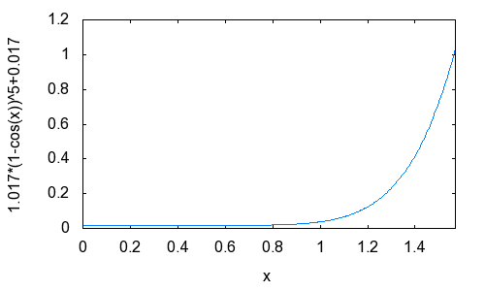
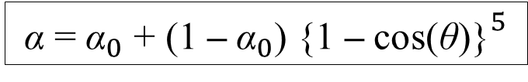
Our Objective Optical Phenomenon
Fresnel reflection
The Fresnel coefficient α is a function of the incident angle θ
α = ${\text{α}}_{0}$ + (1 – ${\text{α}}_{0}$) {1 – cos(θ)${\text{\}}}^{5}$
(Schlick’s approximation [Schlick 1994], α₀: constant)
α
1
θ
0
90°
α increases monotonically when θ is large
Notes:
The Fresnel coefficient alpha is a function of the incident ray’s angle theta.
Larger theta results in large alpha, then the observed color is dominated by the reflection color R.
The alpha matte is visualized in the lower right image. The blight pixels denote large alpha values.
In this example, the surface is wavy, so the alpha matte also varies according to the waves.

Slide 11


Our Objective Optical Phenomenon
Fresnel reflection
α increases monotonically when θ is large
θ
θ
near side: small θ → small α
I = α R + (1 – α) T
far side: large θ → large α I = α R + (1 – α) T
R dominant
large α
T dominant
small α
Input image w/ flat surface
Smooth α matte
Notes:
The Fresnel coefficient alpha is a function of the incident ray’s angle theta.
Larger theta results in large alpha, then the observed color is dominated by the reflection color R.
The alpha matte is visualized in the lower right image. The blight pixels denote large alpha values.
In this example, the surface is wavy, so the alpha matte also varies according to the waves.

Slide 12
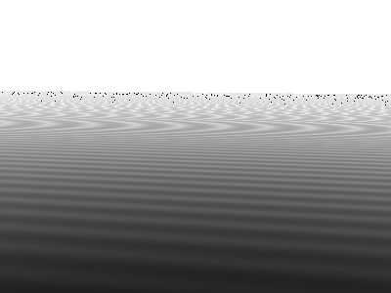
Our Objective Optical Phenomenon
Fresnel reflection
in case of wavy surfaces, θ is warped due to waves
θ
θ
We must extract wavy α matte
Input image w/ wavy surface
Wavy α matte
Notes:
The Fresnel coefficient alpha is a function of the incident ray’s angle theta.
Larger theta results in large alpha, then the observed color is dominated by the reflection color R.
The alpha matte is visualized in the lower right image. The blight pixels denote large alpha values.
In this example, the surface is wavy, so the alpha matte also varies according to the waves.

Slide 13
Our Method
Notes:
Now I explain our method.

Slide 14
Matting Equation
For each pixel x = (x, y)^{T},
An ill-posed problem
Only 3 knowns ( I ) available for 7 unknowns ( R, T and α )
Input
Reflection component
I(x) = α(x) R(x) + (1 – α(x)) T(x)
α matte (Fresnel coefficients)
Transmission component
We make 3 assumptions

Slide 15
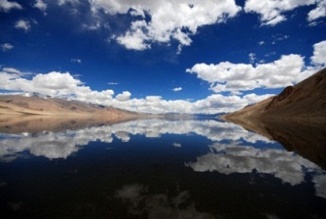

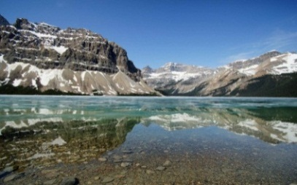
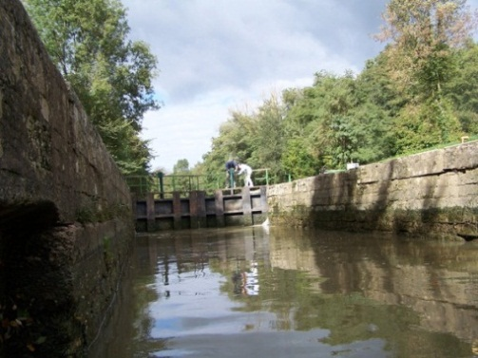
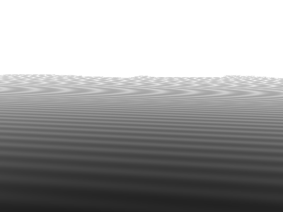
Our Assumptions
Transmission color T is approximately uniform
A pair of a real object and its corresponding reflection can be found in the input image
The reflection surface is mostly planar but possibly wavy
OK
NG
Notes:
Our first assumption is that, the transmitted color is uniform over the reflection region.
For example, we handle images like these, but we don’t handle images with complicated transmitted patterns like this.
Second, we assume that a real object which causes reflection is also included in the input image.
We use the color of the real object to estimate R.
Third, we assume the reflection plain is almost flat but possibly wavy.

Slide 16

Our Assumptions
Transmission color T is approximately uniform
A pair of a real object and its corresponding reflection can be found in the input image
The reflection surface is mostly planar but possibly wavy
OK
NG
Notes:
Our first assumption is that, the transmitted color is uniform over the reflection region.
For example, we handle images like these, but we don’t handle images with complicated transmitted patterns like this.
Second, we assume that a real object which causes reflection is also included in the input image.
We use the color of the real object to estimate R.
Third, we assume the reflection plain is almost flat but possibly wavy.
三つの仮定のうち一つ目では、透過色T が映り込み全体で一様であると近似します。
例えばこのような（アニメ）画像を対象とし、このような（アニメ）複雑な模様が透過しているものは対象とはしません。
二つ目は、入力画像中に、映り込んでいる実物体が存在するという仮定を置きます。
これにより、実物体の色から、R を推定することができます。
三つ目として、対象とする反射面が水平面であり、αは滑らかに変化すると仮定します。

Slide 17
Our Assumptions
Transmission color T is approximately uniform
A pair of a real object and its corresponding reflection can be found in the input image
The reflection surface is mostly planar but possibly wavy
OK
NG
Notes:
Our first assumption is that, the transmitted color is uniform over the reflection region.
For example, we handle images like these, but we don’t handle images with complicated transmitted patterns like this.
Second, we assume that a real object which causes reflection is also included in the input image.
We use the color of the real object to estimate R.
Third, we assume the reflection plain is almost flat but possibly wavy.
三つの仮定のうち一つ目では、透過色T が映り込み全体で一様であると近似します。
例えばこのような（アニメ）画像を対象とし、このような（アニメ）複雑な模様が透過しているものは対象とはしません。
二つ目は、入力画像中に、映り込んでいる実物体が存在するという仮定を置きます。
これにより、実物体の色から、R を推定することができます。
三つ目として、対象とする反射面が水平面であり、αは滑らかに変化すると仮定します。

Slide 18
Our Assumptions
Transmission color T is approximately uniform
A pair of a real object and its corresponding reflection can be found in the input image
The reflection surface is mostly planar but possibly wavy
OK
NG
Notes:
Our first assumption is that, the transmitted color is uniform over the reflection region.
For example, we handle images like these, but we don’t handle images with complicated transmitted patterns like this.
Second, we assume that a real object which causes reflection is also included in the input image.
We use the color of the real object to estimate R.
Third, we assume the reflection plain is almost flat but possibly wavy.

Slide 19
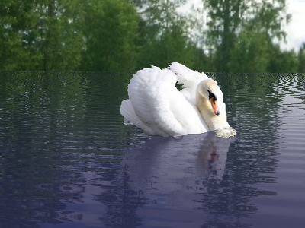
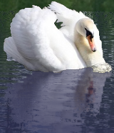
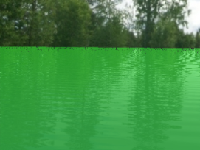
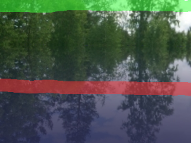
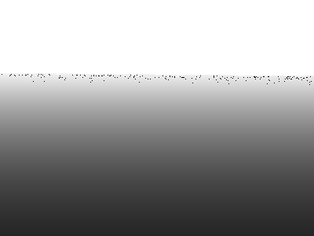

Overview
New object
Composite result with plausible reflection
Input image I
User input
Compositing
Matting
Estimate T
Estimate α
Estimate R
Refine R & α
Notes:
This is the overview of our method.
Given the input image I and some user markups, our method calculates matting.
It first estimate the transmitted color T, assuming the color is constant.
Then, it estimate the smooth alpha matte and the reflection color R.
To account for the wavy surface, our method further refines the R and alpha.
After the matting is done, a user can composite a new object into the input image with plausible reflection.

Slide 20

Overview
New object
Composite result with plausible reflection
Input image I
User input
Compositing
Matting
Estimate T
Estimate α
Estimate R
Refine R & α

Slide 21
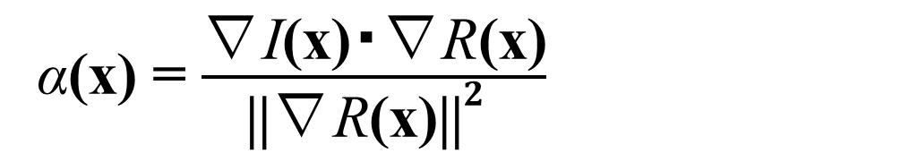
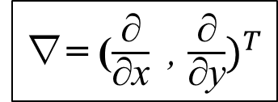
Estimating Transmission Component T (1/2)
If the transmission component T is uniform
On the other hand, α can be computed using I and R
By taking luminance gradients and assuming smooth α:
I(x) = α(x) R(x) + (1 – α(x)) T
T can be calculated using α and R just in a partial region
α(x) = $\frac{\text{∇}\text{I}\text{(}\text{x}\text{)}\text{・∇}\text{R}\text{(}\text{x}\text{)}}{\text{||}\text{∇}\text{R}\text{(}\text{x}\text{)}{\text{||}}^{2} }$
∇= ($\frac{\text{∂}}{\text{∂}\text{x}}$, $\frac{\text{∂}}{\text{∂}\text{y}})^{T}$
Notes:
First I explain how to estimate the transmission component T.
Using the assumption that T is uniform, we can rewrite the matting equation as follows.
Then, T is the same for each pixel x, so we can estimate T using alpha and R only in a partial region.
By the way, alpha can be calculated using the following equation.
By applying gradients to the above equation, we can omit T, and then alpha can be calculated from I and R.
To summarize, we can calculate alpha and then T, if we know R only in a partial region.

Slide 22



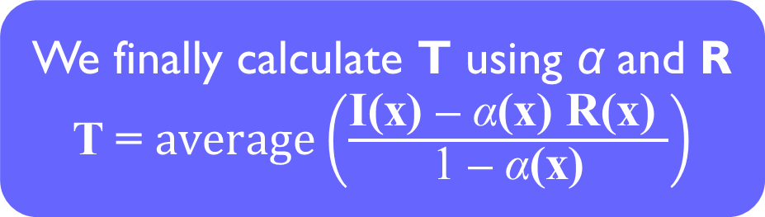
Estimating Transmission Component T (2/2)
Estimating R in a partial region
User specifies object-reflection correspondence
Color transfer [Reinhard et. al. 2001] to conform colors
Real object
We finally calculate T using α and R
T = $average\left(\frac{\text{I}\text{(}\text{x}\text{) – }\text{α}\text{(}\text{x}\text{) }\text{R}\text{(}\text{x}\text{)} }{\text{1}\text{ – }\text{α}\text{(}\text{x}\text{)}}\right)$
x
Reflection
User markups
Color transferred result
Notes:
Color transfer can convert the color distribution in the small region of the reflections to be similar to that in the small region of the objects

Slide 23
Overview
New object
Composite result with plausible reflection
Input image I
User input
Compositing
Matting
Estimate T
Estimate α
Estimate R
Refine R & α
Notes:
Next I explain how to calculate alpha.

Slide 24
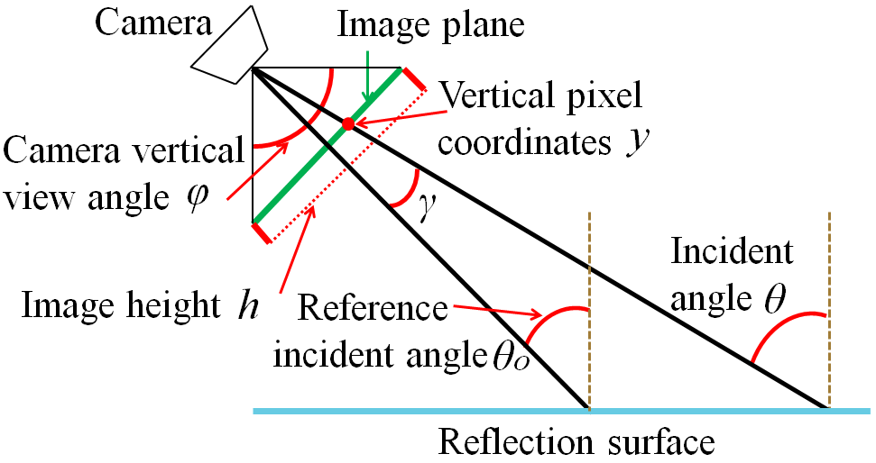
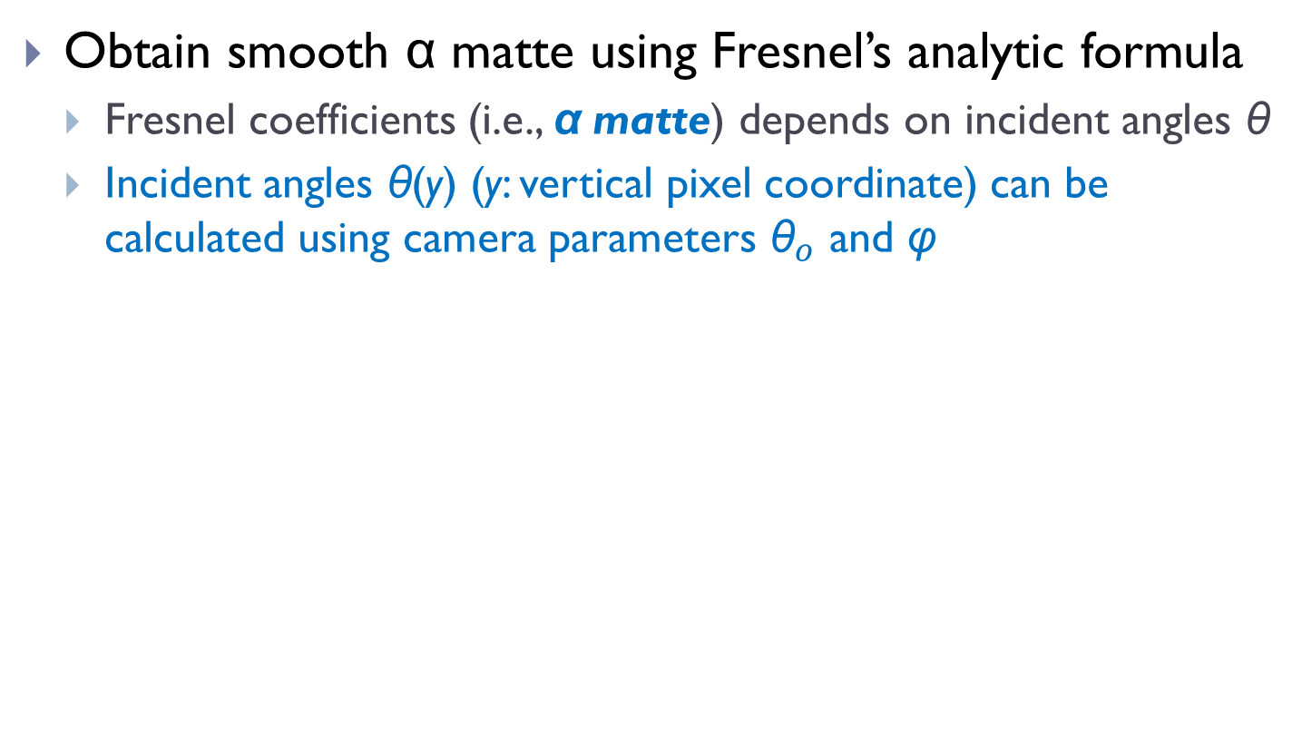
Estimating α Matte (1/2)
Obtain smooth α matte using Fresnel’s analytic formula
Fresnel coefficients (i.e., α matte) depends on incident angles θ
Incident angles θ(y) (y: vertical pixel coordinate) can be calculated using camera parameters ${\text{θ}}_{o}$ and φ
Notes:
To calculate the alpha matte robustly, we compute it using the incident angle theta based on the Fresnel law.
The angles can be easily computed in the case of a horizontal surface.
Although we omit the detail today, we can calculate theta if we know how oblique the camera is against the reflection surface.
So, we estimate the required camera parameters, theta_o and phi, as shown in this illustration.

Slide 25
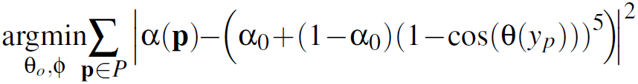
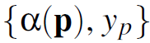
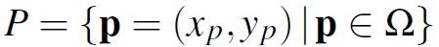
Estimating α Matte (2/2)
Estimating camera parameters
We solve the following minimization problem
Samples are collected in a similar way to Robust matting [Wang et al. 2007]
: training samples
: a set of training sample positions
Notes:
The camera parameters are estimated via a maximum likelihood estimation.
We assume a probabilistic model according to the Fresnel equation like this.
Levenberg-Marquart method
Here, alpha(p) and yi are training samples. These samples are obtained by sampling the input image in a similar way to the Robust matting.
Please refer to our paper for more details.

Slide 26
Overview
New object
Composite result with plausible reflection
Input image I
User input
Compositing
Matting
Estimate T
Estimate α
Estimate R
Refine R & α
Notes:
Next I explain how to calculate R.

Slide 27



Estimating Reflection Component R
R can be calculated by the matting equation
But α is smooth, R contains high-frequency residuals
I(x) = α(x) R(x) + (1 – α(x)) T
Ground truth
Input
Current α
Current R
Notes:
Now we already know T and alpha, R can be calculated from the matting equation.
But, the alpha matte calculated so far is smooth, assuming that surface is completely flat.
In case of wavy surfaces, artifacts appear in resultant R if we use such smooth alpha matte.
The wavy pattern should appear in the alpha matte because waves change incident angles of rays.

Slide 28
Overview
New object
Composite result with plausible reflection
Input image I
User input
Compositing
Matting
Estimate T
Estimate α
Estimate R
Refine R & α
Notes:
So, we refine R and alpha to account for wavy effects.

Slide 29

Modified R and α (1/3)
We smooth the residuals in R
Edges in R might be caused by wavy α matte
Smooth the residual only, but preserve the inherent edges in R
then recompute α using matting equation with R
Too smooth
Gaussian filter
R with residuals
Smoothed R
Notes:
To eliminate the wavy effects in R, we apply a smoothing filter to R.
Here please note that we have to keep the intrinsic edges of the reflection image and only smooth out the wavy effects.
If we use conventional smoothing filter, say Gaussian like this, the edges of the reflection image are also smoothed out.
To handle this, we propose a novel filter. The right image shows our result.

Slide 30
Modified R and α (1/3)
We smooth the residuals in R
Edges in R might be caused by wavy α matte
Only smooth the residual, but preserve the inherent edges in R
then recompute α using matting equation with R
Our filter
R with residuals
Smoothed R
Notes:
To eliminate the wavy effects in R, we apply a smoothing filter to R.
Here please note that we have to keep the intrinsic edges of the reflection image and only smooth out the wavy effects.
If we use conventional smoothing filter, say Gaussian like this, the edges of the reflection image are also smoothed out.
To handle this, we propose a novel filter. The right image shows our result.

Slide 31
Modified R and α (2/3)
We smooth R(x₁) and R(x₂) if they are really similar colors
where x₁ and x₂ are neighboring pixels
G
R(x₁)
We smooth them if they are close, but we don’t know true values
I(x₁)
R(x₂)
α(x₁)
R
I(x₂)
α(x₂)
B
T
Notes:
Now I explain how we designed the filter.
I first illustrate the relationship among R, T and alpha in the matting equation using the right image.
If we smooth pixels x and y, we consider I(x) and I(y), which are the linear combination of R and T based on the matting equation.
Then, each alpha denotes the scaling ratio as shown in the image.
The estimated R contains wavy effects and we don’t know the true values of R as shown in the image.
On the other hand, we already know I and T, so we can calculate vectors I – T.
Then, we notice the angle w’ between two vectors.
If the true R for x and y are similar, then the angle becomes small.
And the angle becomes large if the true R for x and y differ a lot.
So we use the angle as the weight for an edge-aware smoothing filter.
Using this filter, we can keep the intrinsic edges of the reflection image, while smoothing out the wavy effects.

Slide 32
Modified R and α (2/3)
We smooth R(x₁) and R(x₂) if they are really similar colors
where x₁ and x₂ are neighboring pixels
G
R(x₁)
I(x), R(x) and T lie in a line: I(x) = α(x) R(x) + (1 – α(x)) T
I(x₁)
R(x₂)
α(x₁)
R
I(x₂)
α(x₂)
B
T
Notes:
Now I explain how we designed the filter.
I first illustrate the relationship among R, T and alpha in the matting equation using the right image.
If we smooth pixels x and y, we consider I(x) and I(y), which are the linear combination of R and T based on the matting equation.
Then, each alpha denotes the scaling ratio as shown in the image.
The estimated R contains wavy effects and we don’t know the true values of R as shown in the image.
On the other hand, we already know I and T, so we can calculate vectors I – T.
Then, we notice the angle w’ between two vectors.
If the true R for x and y are similar, then the angle becomes small.
And the angle becomes large if the true R for x and y differ a lot.
So we use the angle as the weight for an edge-aware smoothing filter.
Using this filter, we can keep the intrinsic edges of the reflection image, while smoothing out the wavy effects.

Slide 33
Modified R and α (2/3)
We smooth R(x₁) and R(x₂) if they are really similar colors
where x₁ and x₂ are neighboring pixels
G
R(x₁)
We know I(x₁) – T and I(x₂) – T, so we measure similarity by angle β
I(x₁)
We use β as the filter weight: small β → more smoothing, large β → less
R(x₂)
α(x₁)
β(x₁, x₂)
R
I(x₂)
α(x₂)
B
T
Notes:
Now I explain how we designed the filter.
I first illustrate the relationship among R, T and alpha in the matting equation using the right image.
If we smooth pixels x and y, we consider I(x) and I(y), which are the linear combination of R and T based on the matting equation.
Then, each alpha denotes the scaling ratio as shown in the image.
The estimated R contains wavy effects and we don’t know the true values of R as shown in the image.
On the other hand, we already know I and T, so we can calculate vectors I – T.
Then, we notice the angle w’ between two vectors.
If the true R for x and y are similar, then the angle becomes small.
And the angle becomes large if the true R for x and y differ a lot.
So we use the angle as the weight for an edge-aware smoothing filter.
Using this filter, we can keep the intrinsic edges of the reflection image, while smoothing out the wavy effects.

Slide 34


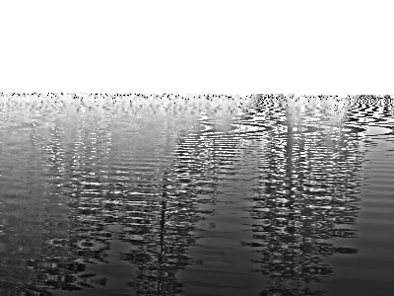
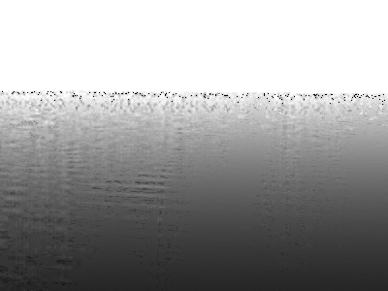
Modified R and α (3/3)
 | Gaussian filter | Bilateral filter | Our filter
Reflection component R
α mattes
too smooth
undesired edges
waves missing
waves!
Notes:
This slide shows a comparison of our filter and other conventional filters.

Slide 35
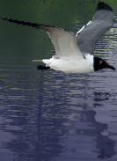
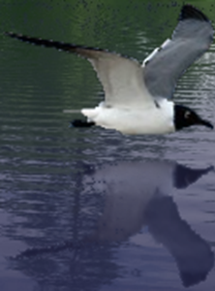
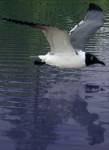
Modified R and α (3/3)
 | Gaussian filter | Bilateral filter | Our filter
Composite results
α mattes
too blurry
not wavy
plausible reflection!
Notes:
This slide shows a comparison of our filter and other conventional filters.

Slide 36
Overview
New object
Composite result with plausible reflection
Input image I
User input
Compositing
Matting
Estimate T
Estimate α
Estimate R
Refine R & α
Notes:
Finally, a user can synthesize a new object using the estimated information.

Slide 37
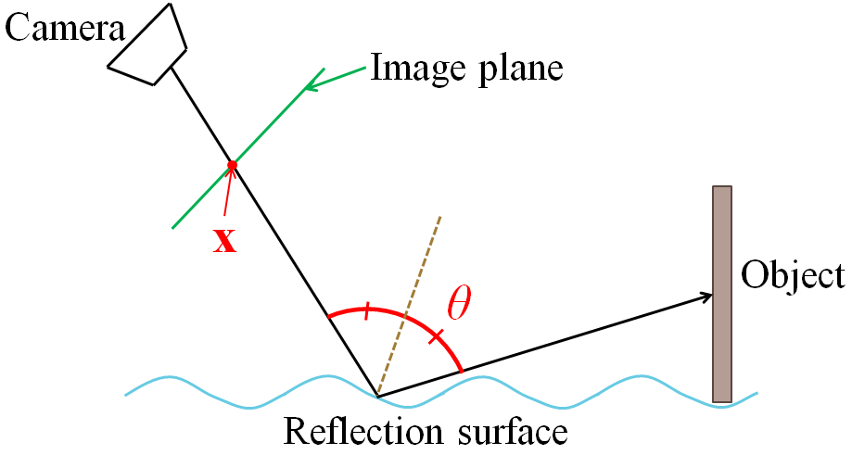
Reflection Composition
New reflection component R_{new} for new object is synthesized to final composite color I_{new}:
We employ ray tracing to compute R_{new}
Composited objects are represented as billboards
Notes:
To composite a new object, we employ ray tracing. The incident angle theta can be calculated from the alpha matte.
The color of the composited reflection image is calculated using the following equation.
The new object is represented as a billboard.

Slide 38
Result

Slide 39
Experimental Settings
Language and libraries
C++
OpenGL, GLUT, DevIL
Experimental environment
Intel Core i7 2.80GHz
2 GB RAM
Notes:
We used the following environment to test our results, and used the following languages and libraries to implement our prototype.

Slide 40
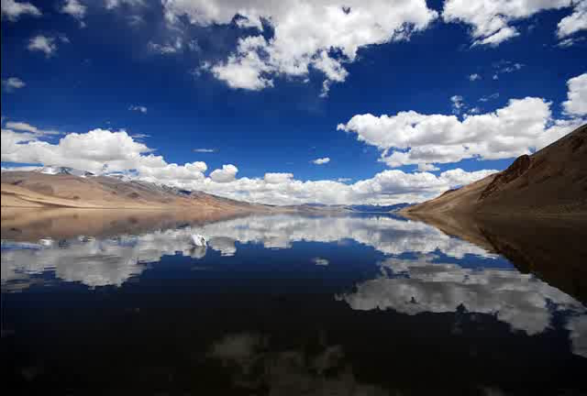
Result: Almost-Flat Water Surface
640×428 pixels matting time: 0.896 sec
Notes:
This movie shows a result with a vertically-varying alpha matte.
As you can see, the reflection color becomes dominant if the object is far, and the transmitted color becomes dominant if the object gets close to the viewpoint.

Slide 41

Result: Wavy Water Surface
640×450 pixels matting time: 7.68 sec
Notes:
This movie shows a result with a wavy water surface. Please note that the reflected image is also plausibly deformed.

Slide 42
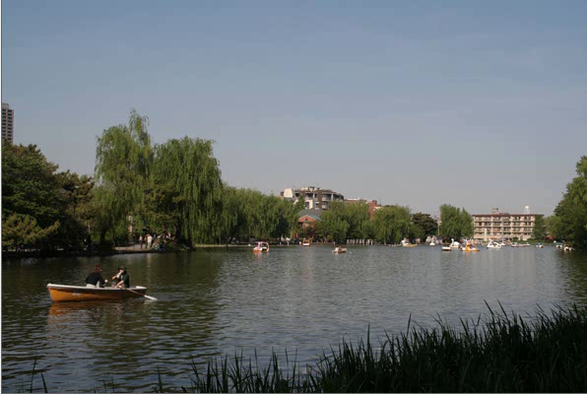
Result: Comparison with Real Reflection
600×400 pixels matting time: 1.40 sec
Notes:
In this movie, I show you a comparison between a real reflection and synthesized reflection of the boat.
As you can see, our synthesized result is sufficiently realistic compared to the real one.

Slide 43
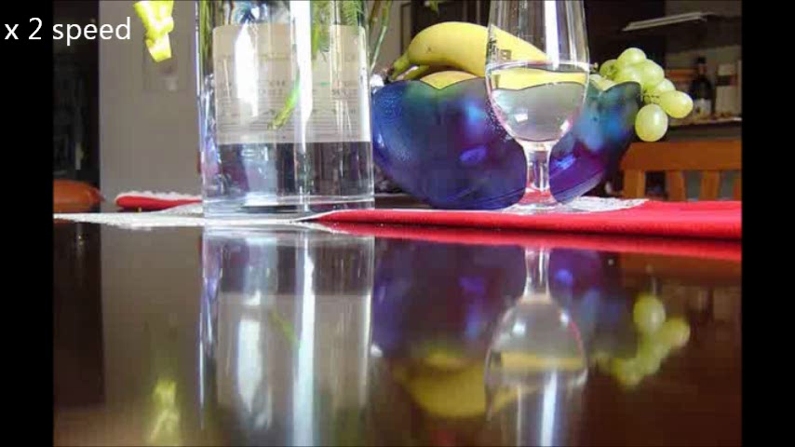
Result: Flat Glossy Tabletop
615×413 pixels matting time: 0.532 sec
Notes:
Our method can be applied to glossy surfaces like a tabletop, as shown in this movie.
We also estimate the camera parameters, so the objects’ sizes can be automatically adjusted.

Slide 44

Result: Wavy Glossy Floor
420×634 pixels matting time: 1.37 sec
Notes:
This is a final example with a wavy glossy floor.

Slide 45

Limitation
Billboard approximation used in ray tracing can result in reflections with an unnatural appearance
Tops of the tea cups are rendered in reflections
Notes:
Our method has some limitations. Except for our three assumptions, the most significant one is the artifact due to billboard approximation used in ray tracing.
In this image, the tops of the teacups should not be seen. This artifact can be avoided if we consider the geometry of the object.

Slide 46
Conclusion
Matting and compositing method for reflections in images
First work to create α mattes for complicated reflection
We have demonstrated visually plausible composited reflection
Future work
Insertion of 3D meshes into the scene for better reflection
More sophisticated smoothing to eliminate waves using, e.g., L0 image smoothing [Li et al. 2011]
Notes:
We have presented a method of matting and compositing for reflections in images
Our work is the first to produce mattes for complicated reflection
We have demonstrated that proposed method generates visually plausible composited reflection
Future work
Additional information will improve rough geometric calibration
Insertion of 3D meshes into the scene
More sophisticated smoothing to eliminate waves
L0 Image smoothing method [Li et al. 2011]

Slide 47
Thank You!

